Slide 1

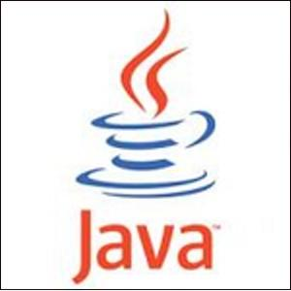
Marwadi Education Foundation’s Group of Institutions Faculty of Computer Applications MCA Sem- III
Fundamental of Java Programming
(630002)
Unit – 2
Using of Java APIs

Slide 2
Introduction
Java API is nothing but a set of classes and interfaces that comes with the JDK. Java API is actually a huge collection of library routines that performs basic programming tasks such as looping, displaying GUI form etc.
In the Java API classes and interfaces are packaged in packages. All these classes are written in Java programming language and runs on the JVM. Java classes are platform independent but JVM is not platform independent. You will find different downloads for each OS.

Slide 3
Components of Java
The Java comprises three components:
(1) Java Language
(2) JVM or Java Virtual Machine and
(3) The Java API (Java programming interface)
The Java language defines easy to learn syntax and semantics for Java programming language. Every programmer must understand these syntax and semantics to write program in Java language.

Slide 4
Type of Java API
Official Java Core API
The official core API is part of JDK download. The three editions of the Java programming language are Java SE, Java ME and Java EE.
(2) Optional Java API
The optional Java API can be downloaded separately. The specification of the API is defined according to the JSR request.
(3) Unofficial APIs
These API's are developed by third parties and can downloaded from the owner website.

Slide 5
Type of Java API
We can refer to all these types of API’s using the following website
http://www.roseindia.net/java/javaapi/java-api.shtml

Slide 6
Thank You

